Slide 1
Social Share Feature
Any merchant with an ItsOnMe gifting menu has the ability to share gift items on social media with our social share feature.
This is how to share gifts to Facebook and turn social into
e-commerce with 3 clicks

Slide 2
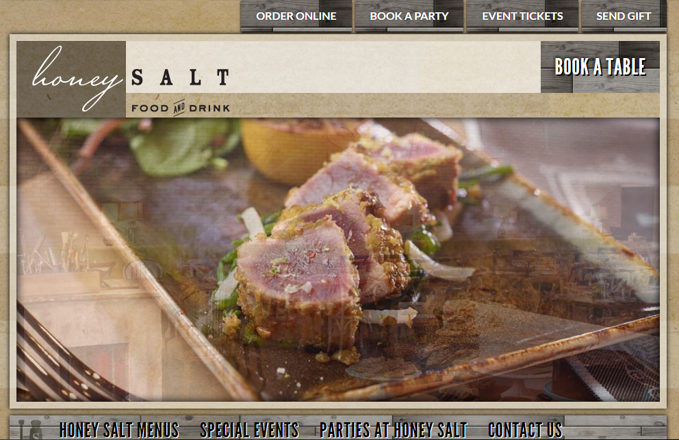
Social Share Feature
Merchant website has “Send Gift” button

Slide 3
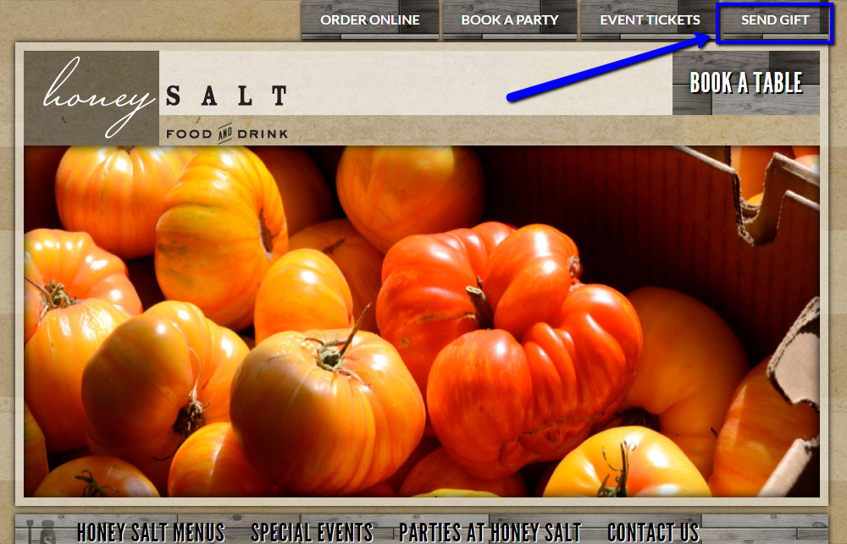
Social Share Feature
Select “Send Gift”

Slide 4
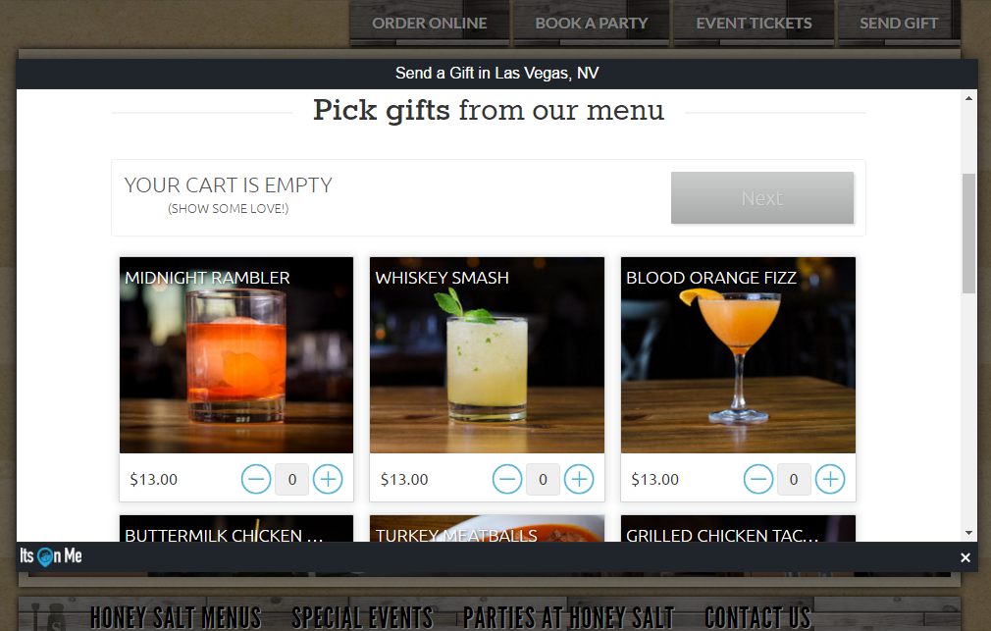
Social Share Feature
Widget opens to reveal gifting menu

Slide 5
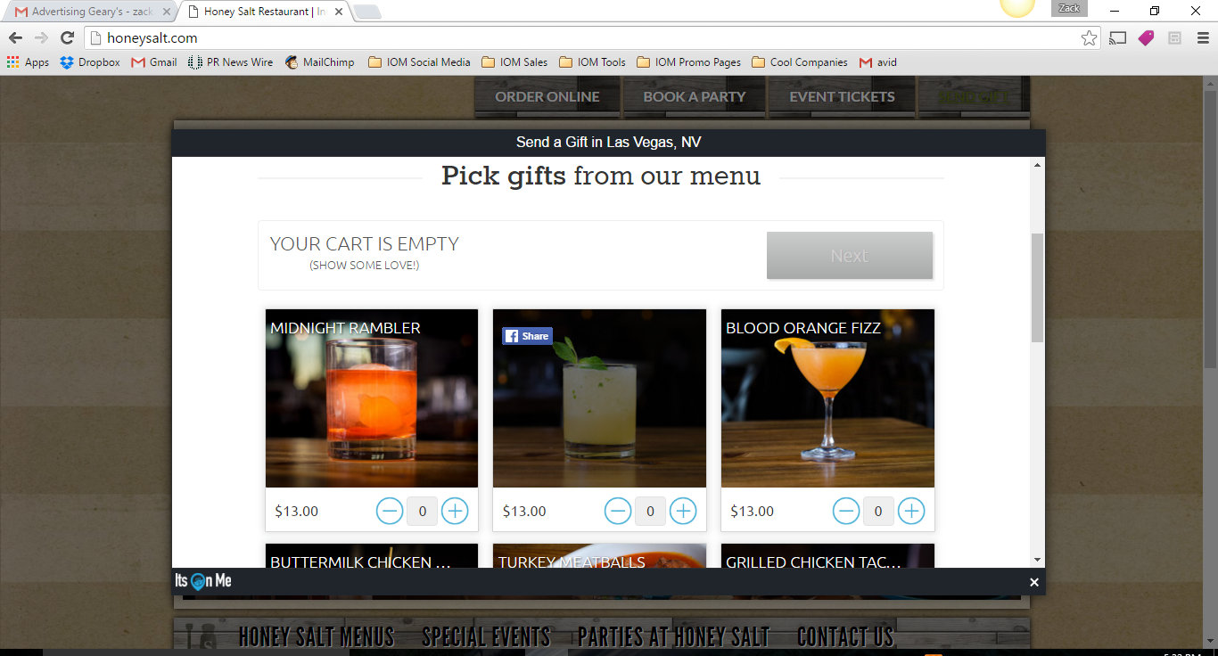
Social Share Feature
Scroll over item and select Facebook “Share”

Slide 6
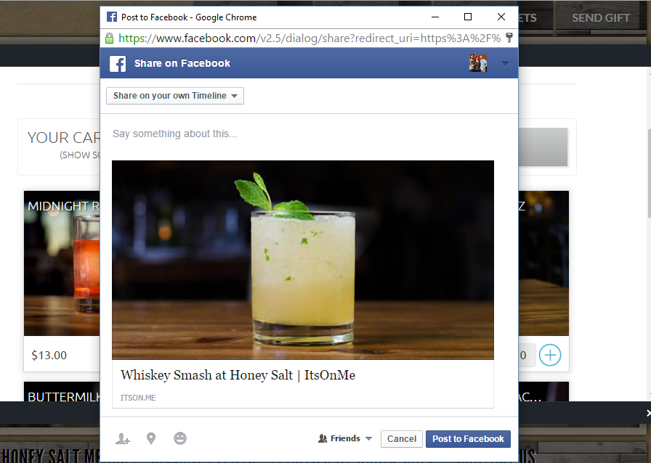
Social Share Feature
Facebook integration automatically opens allowing social sharing from company page

Slide 7
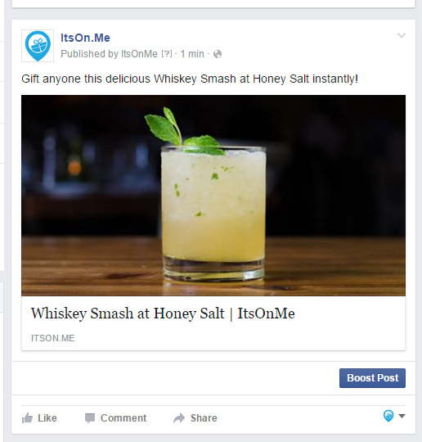
Social Share Feature
Post gift directly to Facebook wall

Slide 8
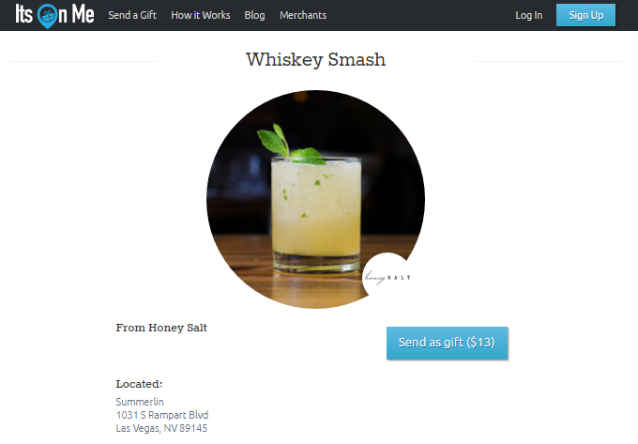
Social Share Feature
Anyone that clicks on post will be given the option to purchase this gift in just two clicks

Slide 9
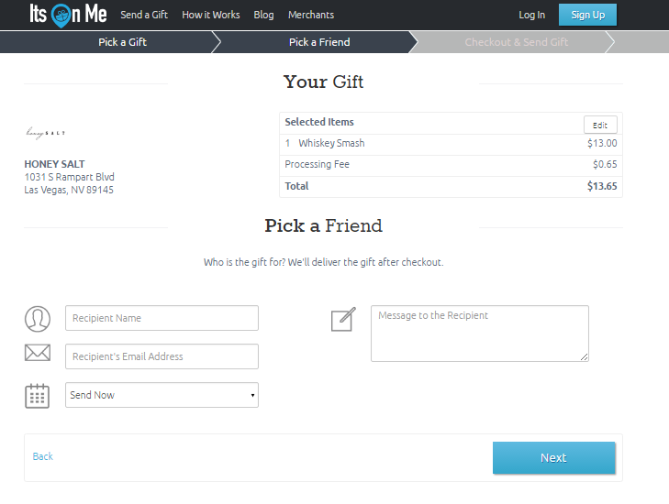
Social Share Feature
Purchaser enters recipient information and chooses to send gift instantly or schedules a delivery date

